Slide 1
Digital Electronics and Systems Number System

Slide 2
Contents
Number System
Unsigned numbers
Representation of numbers of different radix
Decimal number Conversion

Slide 3
Number System
In digital electronics, number system is used for representing the information.
Number System
Unsigned
(only positive)
Signed
(both positive & negative)

Slide 4


Unsigned numbers
Positional Number representation:
A number is represented by a string of digits where each digit position has an associated weight.
In decimal system, a number consists of digits that have 10 possible values from 0 to 9.
eg: 8547 represents
An n-digit decimal integer is represented by
Its value is

Slide 5
Contd…..
In decimal system, since the digits have 10 possible values and each digit is weighted as a power of 10, it is called Base-10 or Radix-10 numbers.
The weight is based on the radix of the number system
Some common radices are:
Decimal
Binary
Octal
Hexadecimal

Slide 6
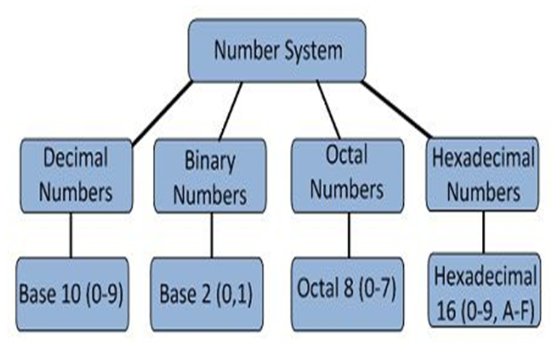

Slide 7

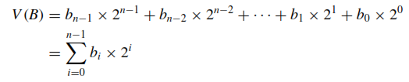
Binary representation
In binary or base-2 system, the digits can be 0 or 1.
Each binary digit is called a bit.
An n-bit binary number is represented by
It has a value
A group of 4 bits nibble
A group of 8 bits byte

Slide 8


Octal and Hexadecimal Representation
Positional number representation can be used for any radix
If the radix is r, then the number
has the value
Numbers represented with radix 8 are called octal numbers, while radix-16 numbers are called hexadecimal numbers.
In octal representation the digit values range from 0 to 7.

Slide 9
Contd….
In hexadecimal representation, each digit can have one of 16 values.
First 10 are same as in decimal system.
Digits that corresponds to the decimal values 10,11,…15 denoted by A,B,C,D,E,F.

Slide 10
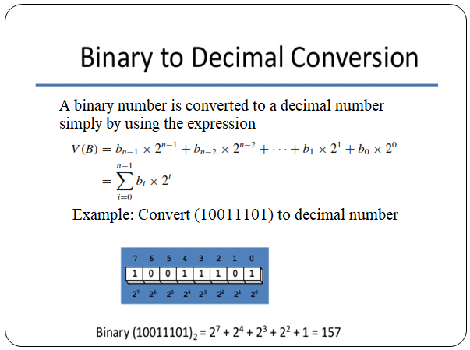

Slide 11
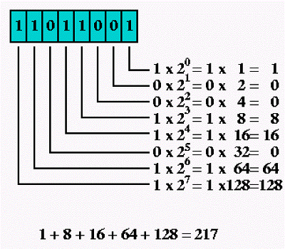
Example:

Slide 12
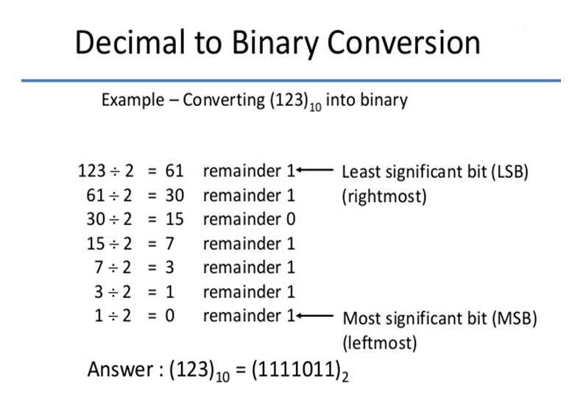
(Successive Division method)

Slide 13
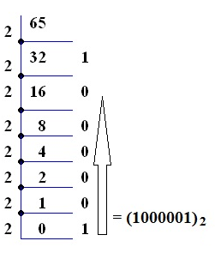
Example: Convert (65)10 to binary

Slide 14
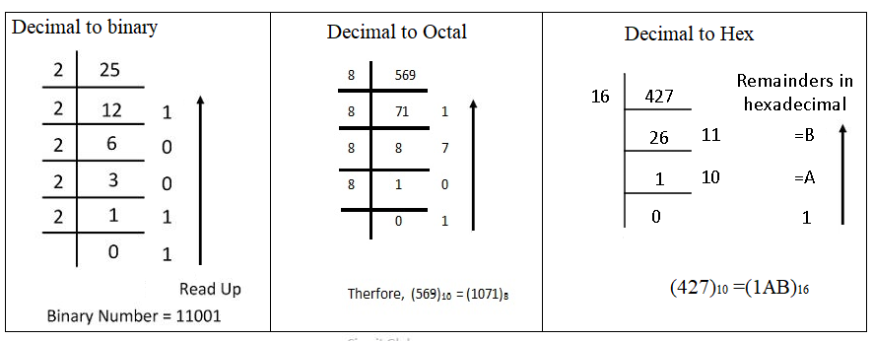
Decimal number conversion: summary
For converting decimal number to binary/octal/hex, we use successive division method.

